Slide 1
Step by Step – Page 20
Go to Data View & Click on Modeling -> Calculations -> New Table
Type ALLGeo = All(GeoDim)
Step 1, 1 Column All – ALLGEORegion = all(GeoDim[Region])
Step 1, 2 columns Return ALLGEORegionState = all(GeoDim[Region], GeoDim[State])
Student Notes

Slide 2
Step by Step – Page 21
Create Filtered Table
ALLGEO_Filtered = FILTER(ALL(GeoDim[Region],GeoDim[State]),
GeoDim[Region] = "East")
Student Notes

Slide 3
Step by Step – Page 39
Use Calculate =
[Desktop Sales] = CALCULATE([Total Sales], CampaignDim[Device] = "Desktop")
[Tablet Sales] = CALCULATE([Total Sales], CampaignDim[Device] = “Tablet")
[Mobile Sales] = CALCULATE([Total Sales], CampaignDim[Device] = “Mobile")
Student Notes

Slide 4
Step by Step – Page 40
Desktop Sales
Go to Report, add new page and all all 4 measures in a table and also State.
Add State, City, and Year as filters.
Use Calculate =
Total Sales All Geo = CALCULATE([Total Sales], ALL(GeoDim))
Total Sales All States = CALCULATE([Total Sales], ALL(GeoDim[State]))
Total Sales All Selected States = CALCULATE([Total Sales], ALLSELECTED(GeoDim[State]))
Show how they all work…
How selecting a city (Aurora) with no state and Colorado selected differs.
Or Alabama, Alexandria as city
Why does Total Sales show $790,
ALL GEO is all,
All States is $89k, Selected is $790
Student Notes

Slide 5
Step by Step – Page 41
Add a page with Month Name and Total Sales table
Add a Year Slicer
Create a measure of total sales 2014
[2014 Sales] = CALCULATE([Total Sales], DateDim[Year] = 2014)
Change Filters Around
Add a measure using Filter
2014 Sales FIL = CALCULATE([Total Sales],
FILTER(DateDim,
DateDim[Year] = 2014))
Change years… why different
Student Notes

Slide 6
Step by Step – Page 42
Calculate inside Calculate
Go to table with devices.
Create this Measure
% Device Sales =
DIVIDE([Total Sales],
CALCULATE([Total Sales],
ALL(CampaignDim[Device])))
Make Percentage
Add filters for year to see how everything works (also add % to table)
Student Notes

Slide 7
Step by Step – Page 43
Using Variable
% Device Sales (var) =
VAR AllDevice = CALCULATE([Total Sales],ALL(CampaignDim[Device]))
Return
DIVIDE([Total Sales],AllDevice)
Student Notes

Slide 8
Step by Step – Page 51
Summarize & MAX or Min
Get to Data View
Click new Cal. Table
Summarize ( Sales, CustomerID, then “FirstPurchaseDate”, MIN(Sales[Date], “DistinctProducts”, distcount(sales[ProductID],”Transactions”, Countrows(Sales))
Student Notes

Slide 9
Step by Step
Create view to see what value is selected
Get Category as a Filter
Add Product, Total Sales, Year as a table and CAtegory
Create a Measure to display the current Product Category
Selected Category = IF(ISFILTERED(ProductDim[Category]),
SELECTEDVALUE(ProductDim[Category],"Mul. Selected"),"No Category Sel.")
Add a Card visual and add the measure we created
Student Notes

Slide 10
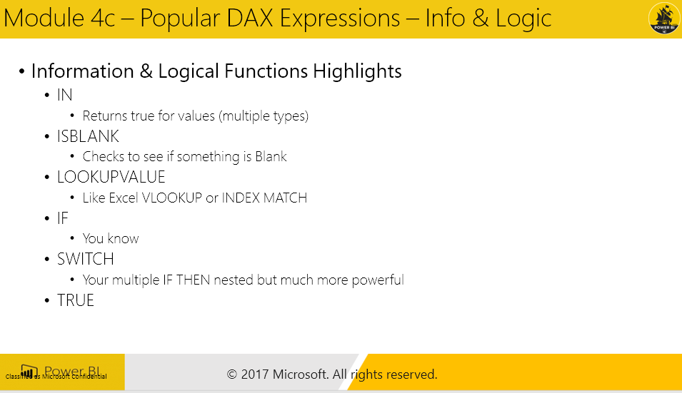
Step by Step
Filter for IN
Calculate, Total sales , GeoDim[State] IN {“NY”,”FL”})
Name it Best States
New Measure of % New States of Total
% Best State Sales = DIVIDE([Best State Sales],[Total Sales],BLANK())
Add to Measure
Student Notes

Slide 11
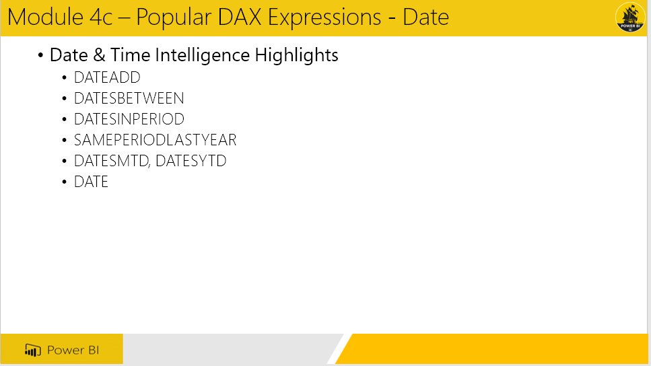
Step by Step
Create MtD with Date
% Best State Sales = DIVIDE([Best State Sales],[Total Sales],BLANK())
Why is it Blank?
Because Date table is looking at the latest on that measure
Let’s do it again, but use date from Sales
Total Sales MtD UPD = CALCULATE([Total Sales],
DATESMTD(Sales[Date]))
What is it doing, and if you filter by Year?
It is looking at THIS MONTH with the current YEAR value selected.
So 2014 filtered and Desktops means:
Total Sales Month to Date (July) in 2014 for Desktop
Let’s add a Previous Year Comparison
Total Sales PM MtD = CALCULATE([Total Sales MtD UPD],
SAMEPERIODLASTYEAR(Sales[Date]))
When you do Sales Date, gives error.
Total Sales PM MtD = CALCULATE([Total Sales MtD UPD],
SAMEPERIODLASTYEAR(DateDim[Date]))
How does it know to look at 2 different dates?
Compare by looking at Year change for each Measures
Current Filter context of MtD, Date Table reflects it!
Add Year as Table, both measures.
Student Notes

Slide 12
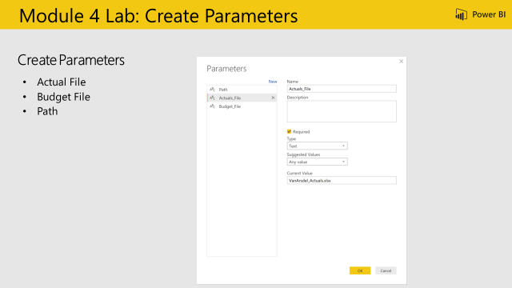
Step by Step
Objective: Update file paths to use dynamic variables
From the Home Ribbon > Manage Parameters
Create a new Parameter
Parameter Name: Path
Type: Text
Current Value = C:\Power BI_Adv_M\
Create a new Parameter
Parameter Name: Actuals_File
Type: Text
Current Value = VanArsdel_Actuals.xlsx
Create a new Parameter
Parameter Name: Budget_File
Type: Text
Current Value = VanArsdel_Budget.csv
Update the text files to ensure the parameter names are consistent
Student Notes

Slide 13
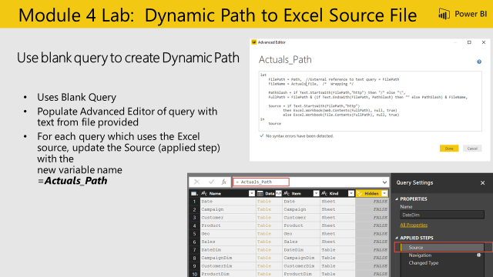
Step by Step
Objective: Create a query to validate if source is Web or Local and resolve path
Create a new blank query
Query Name: “Actuals_Path”
Text as shown in slide (white box)
Update Source Applied Step to use Resolved Path = “Actuals_Path” to the following Queries:
CampaignDim
CustomerDim
ProductDim
CatSegDim
DateDim
GeoDim
SalesFact
Student Notes

Slide 14
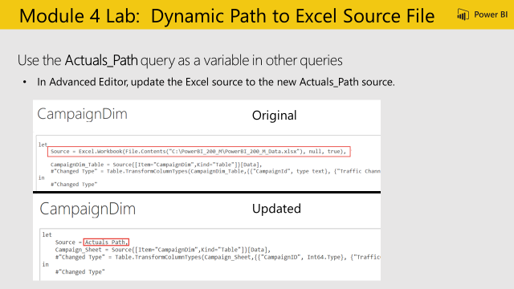
Step by Step
Student Notes

Slide 15
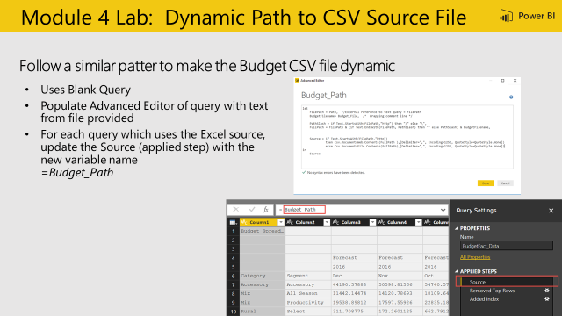
Step by Step
Objective: Update CSV file paths to use dynamic variables
Create a new blank query
Query Name: “Budget_Path”
Copy in text from Budget_Path.txt
Update Source Applied Step to use ResolvedBudgetPath = “Budget_Path” to the following Queries:
BudgetFact
BudgetFact_Data
Student Notes

Slide 16
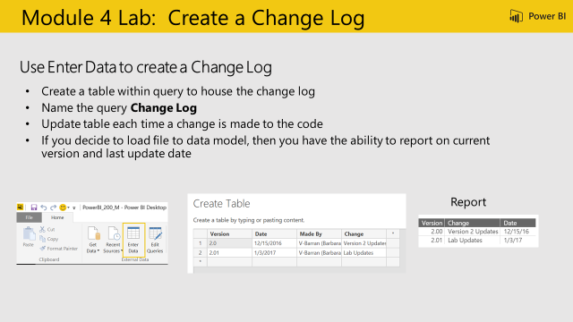
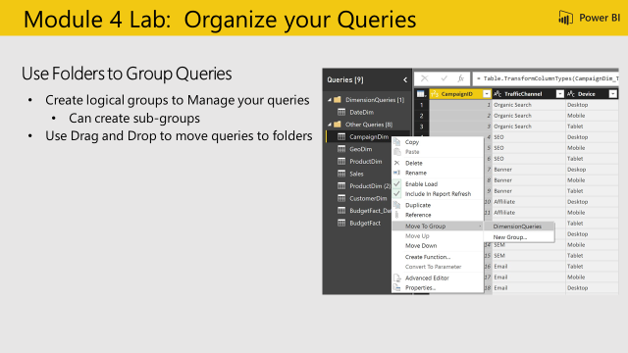
Student Notes
Student Notes

